Slide 1







NADI ELECZONE SOLUTION
SA0311162-x
TRAINING MODULE
INTERNET OF THINGS (IOT)
ADVANCED TRAINING
http://www.nadieleczonesolution.com.my
http://www.facebook .com/eleczone
eleczone_blog@yahoo.com
http://www.Instagram.com/eleczone
019-249 3264

Slide 2


NADI ELECZONE SOLUTION
AZARUL FAHMIN BIN AB HAMID SUNGAI PETANI,KEDAH
19 AUGUST 1992
EDUCATION: -DIPLOMA IN MECHATRONIC ENG. ,2013 -BACHELOR OF SCIENCE MECHATRONIC ENG. , 2017 PAPER: CONNECTED CAR: ENGINE DIAGNOSTIC WITH INTERNET OF THINGS(IoT)
EXPERIENCE: -PROJECT FREELANCE, 2010-2016 -FREELANCE TRAINER, 2012-2016 -TRAINING MANAGER NADI ELECZONE, 2017
PROJECT AND AWARD: -PINTAR (Penanti innovation talent recreation centre) -SCIENCE ON WHEEL(NORTH REGION) -EDUCATION INNOVATION AWARD, YPJ CONTACT NUMBER: 013-4094377

Slide 3
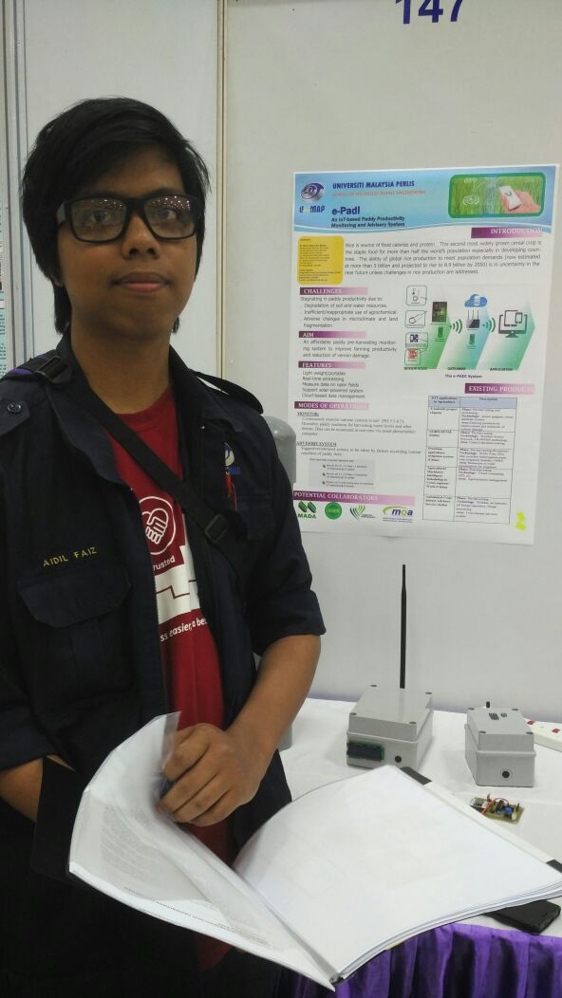
NADI ELECZONE SOLUTION
MUHAMMAD AIDIL FAIZ BIN ISMAIL
KEPALA BATAS, PENANG
25 MARCH 1993
EDUCATION: -DIPLOMA IN MICROELECTRONIC ENG. ,2013 -BACHELOR OF ELECTRONIC ENG. , 2017 PAPER: e-Padi: An IoT Based Paddy Productivity Monitoring System
EXPERIENCE: -PROJECT FREELANCE, 2014-2017 -FREELANCE TRAINER, 2015-2017
PROJECT AND AWARD: -Gold Medal E reka UniMAP 2017 (E padi) -Gold Medal I-Envex 2016 (IoT Clean room monitoring) -SCIENCE ON WHEEL(NORTH REGION)
CONTACT NUMBER: 013 4094377

Slide 4
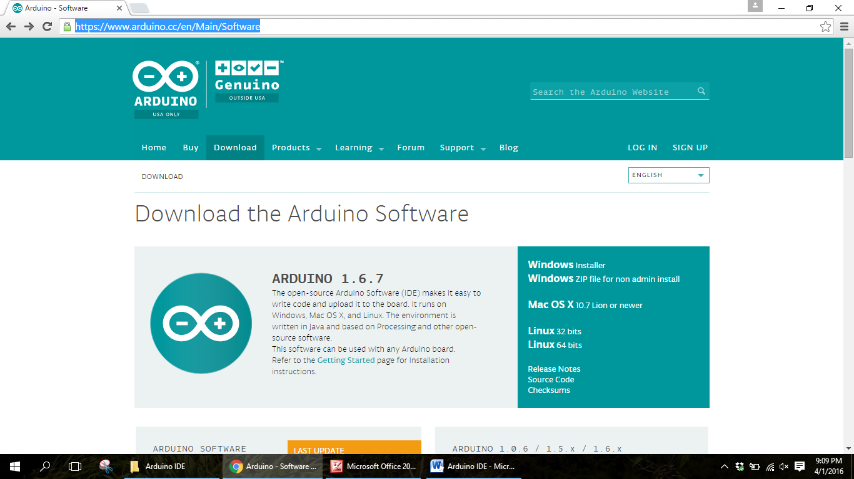



NADI ELECZONE SOLUTION
Installing arduino ide
1
Download the software here!
Go to website url https://www.arduino.cc/en/Main/Software and downlad Arduino IDE software. Take the windows installer or windows zip.
2
Extract the file
If you are taking the windows zip it’s mean you choose non admin install that don’t need t be install. You just have t extract the file
arduino

Slide 5
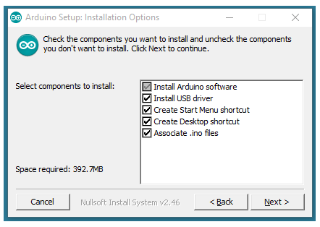

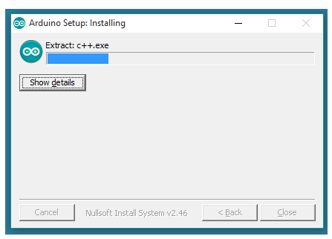
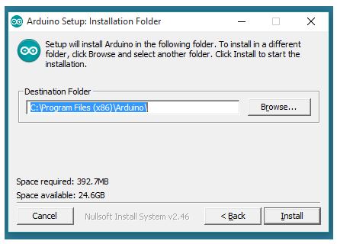
NADI ELECZONE SOLUTION
Installing arduino ide
Step 1
Step 2
Download/ Copy Arduino Software (IDE)
Choose component to Install
Step 3
Step 4
Select Installation Folder (We suggest to use- Default)
This process will extract and Install the file that will be use in Arduino software(IDE)

Slide 6
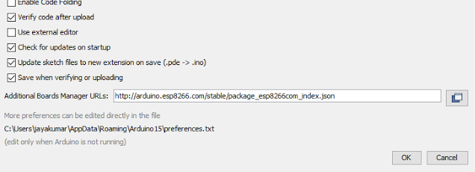
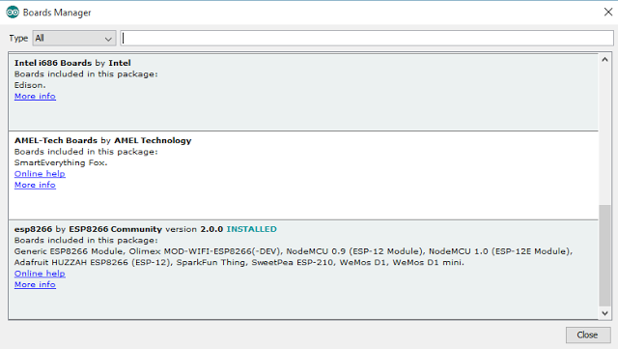
NADI ELECZONE SOLUTION
NodeMCU BOARDLIBRARY SETUP
1
Setting NodeMCU
Go to File → Preferences copy this json url and paste http://arduino.esp8266.com/stable/package_esp8266com_index.json into Additional Board Manager URLS: then click OK
2
Setting NodeMCU
Go to Tools→Boards→Board Manager click Board Manager and then wait for a few minute until nodeMcu library link appear then click Install at esp8266 by ESP8266 community

Slide 7

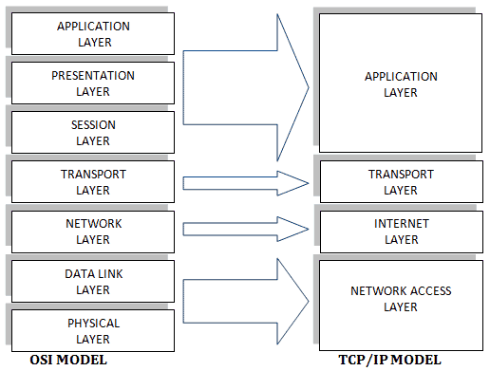
NADI ELECZONE SOLUTION
WHAT IS IOT ?
Internet of Things (IOT)
Internet of Things (IoT), is one of popular word today, but most of person still don’t understand about IoT. For now we are in 4th industry revolution that will use IoT as one of technology component as a physical communication medium. IoT is a technology to communicate data(sensor, decision and etc) between any electronic devices.
Why Internet of Things (IOT)
There are many communication method that can be make in state of wireless but why insist to use IoT as a medium of communication.

Slide 8
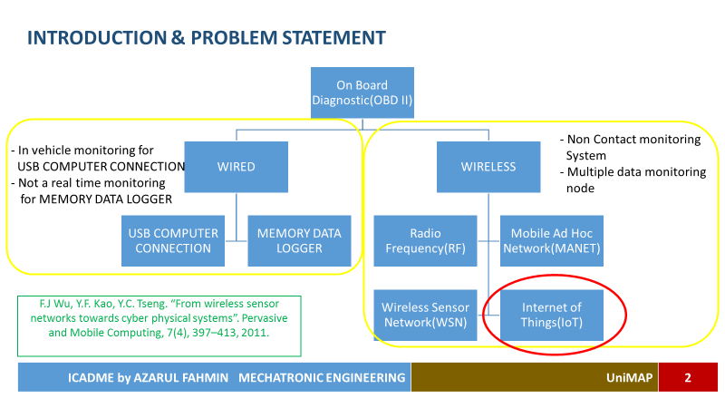
NADI ELECZONE SOLUTION
WHAT IS IOT ?

Slide 9
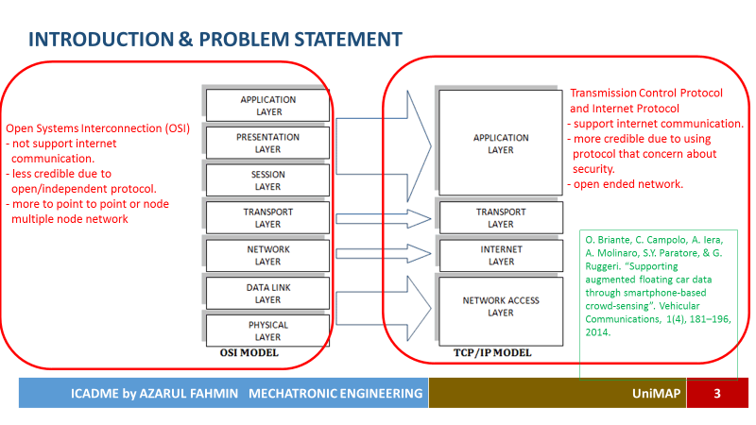
NADI ELECZONE SOLUTION
WHAT IS IOT ?

Slide 10
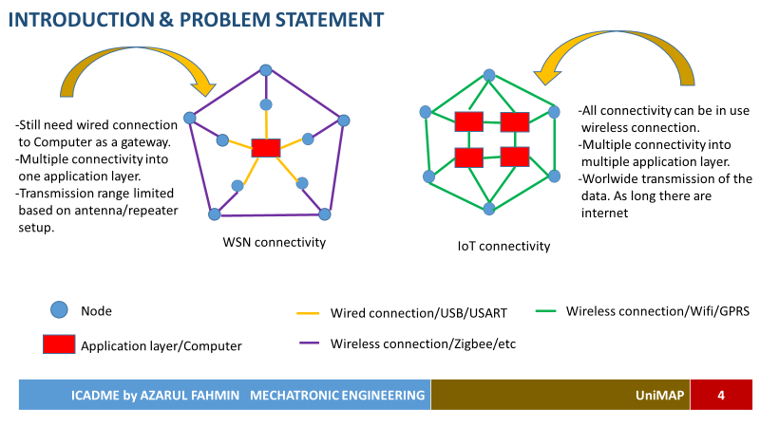
NADI ELECZONE SOLUTION
WHAT IS IOT ?

Slide 11

NADI ELECZONE SOLUTION
WHAT IS IOT ?

Slide 12
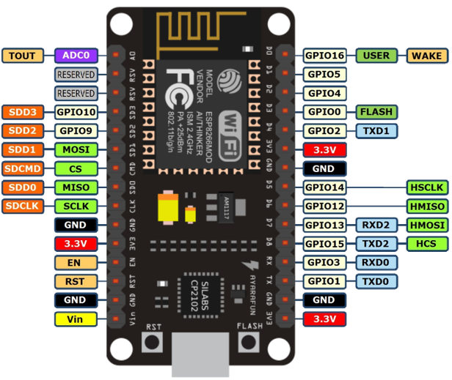


NADI ELECZONE SOLUTION
Get to know NodeMCU (USB Port and GPIO)
1
Function of USB Port
To see NodeMCU Board status
Use to upload compiled code from Arduino IDE into NodeMCU board

Slide 13
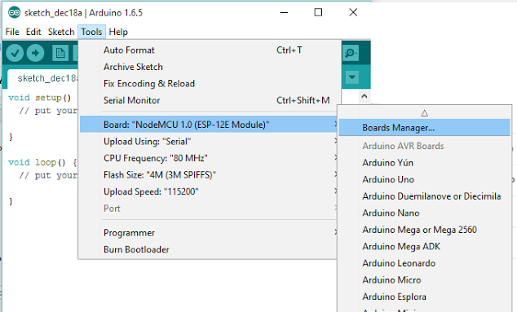
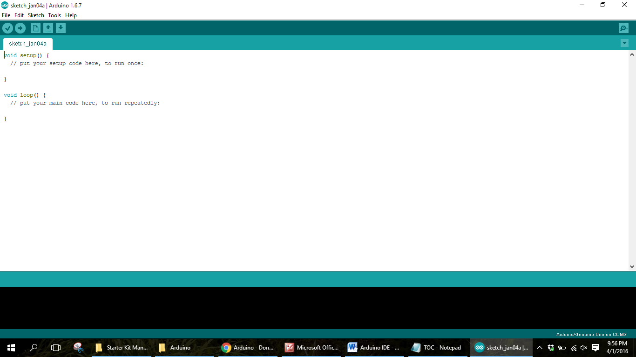
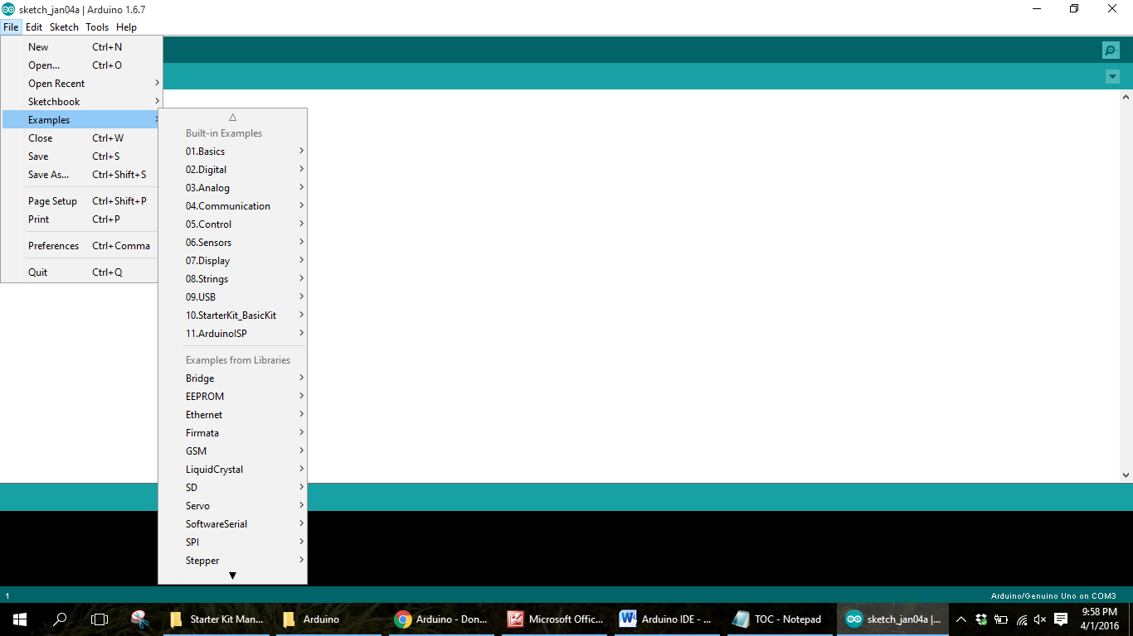
NADI ELECZONE SOLUTION
ARDUINO SETUP
Using Arduino IDE
1
Here you can see if the NodeMCU board already connected to the computer by looking at the port.
What the important thing you need to know when the first time you are using arduino?
2
From here you can get many example coding to be use.
3
Button Verify
Button Upload

Slide 14
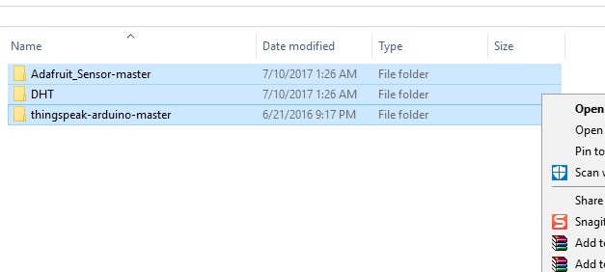
NADI ELECZONE SOLUTION
ARDUINO SETUP
Arduino IDE adding library setup
1
Copy this three library file
2
Paste in C://Program file(x86)/Arduino/libraries

Slide 15
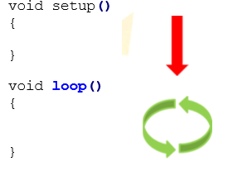
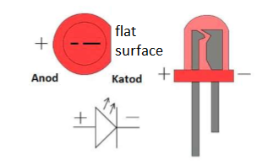
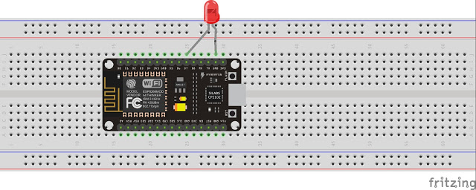
NADI ELECZONE SOLUTION
LESSON 1
1
Connect the LED to NodeMCU board
Lesson 1 : Get to know OUTPUT
Every program in Arduino will have one void setup() and one void loop(). Void setup() is for program code that will running once and void loop() is like main program that will continuously running
D7= pin 13 //folow pin as in GPIO pin out

Slide 16
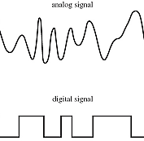
NADI ELECZONE SOLUTION
LESSON 1
1
Algorithm Syntax that widely used in Arduino programming
analogRead(pin) (INPUT)
+ꝏ
analogWrite(pin,value) (OUTPUT)
-ꝏ
digitalRead(pin) (INPUT)
1
0
digitalWrite(pin,value) (OUTPUT)

Slide 17
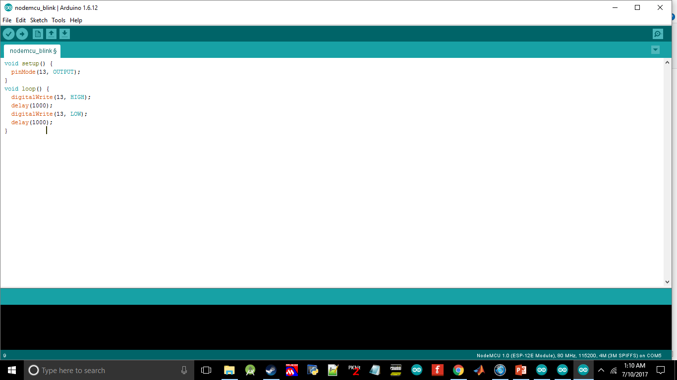
NADI ELECZONE SOLUTION
LESSON 1
2
Write the code in Arduino IDE
After done writing the code click upload and the led will blink continuously with 1 second(delay(1000); = 1000 milisec delay).

Slide 18
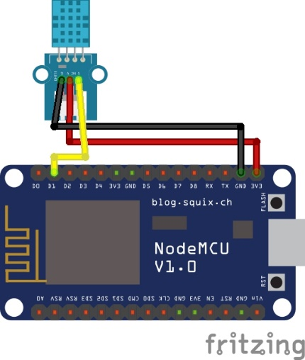
NADI ELECZONE SOLUTION
LESSON 2
1
Lesson 2 : Trying DHT11
DHT11
Sensor pinout
-
OUT
+
3.3V
GND
D1

Slide 19
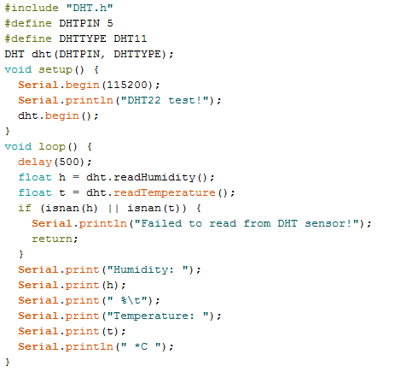
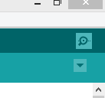
NADI ELECZONE SOLUTION
LESSON 2
1
Library function caller
2
Define sensor pinout
Done? Then go open the Serial Monitor with this icon
Define DHT sensor type
Set Serial Monitor baudrate
Call function to read humidity and temperature value then store it in h and t variable.
Print data to appear in Serial Monitor. Serial.print is for print the value and when it’s come to Serial.println it will go to new line.

Slide 20
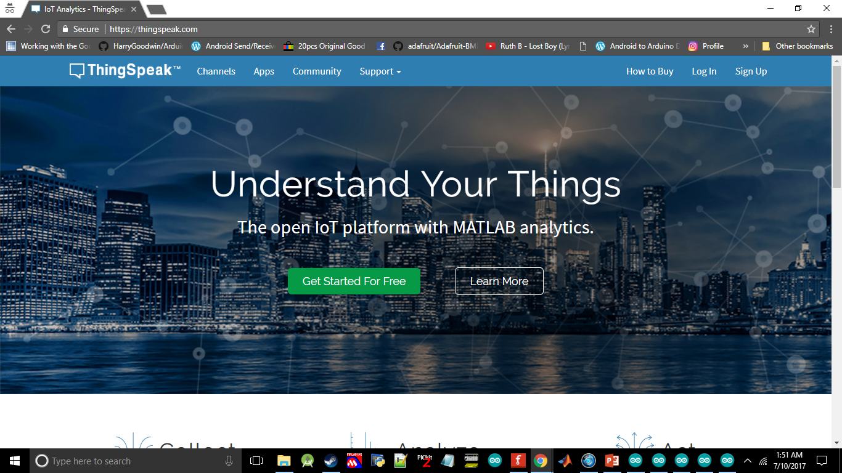
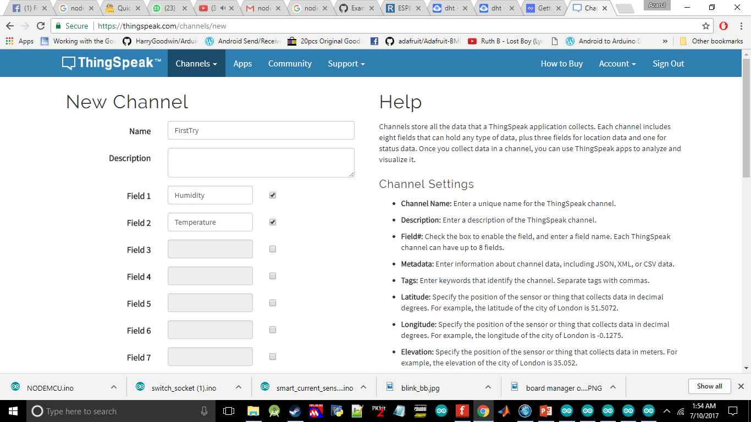
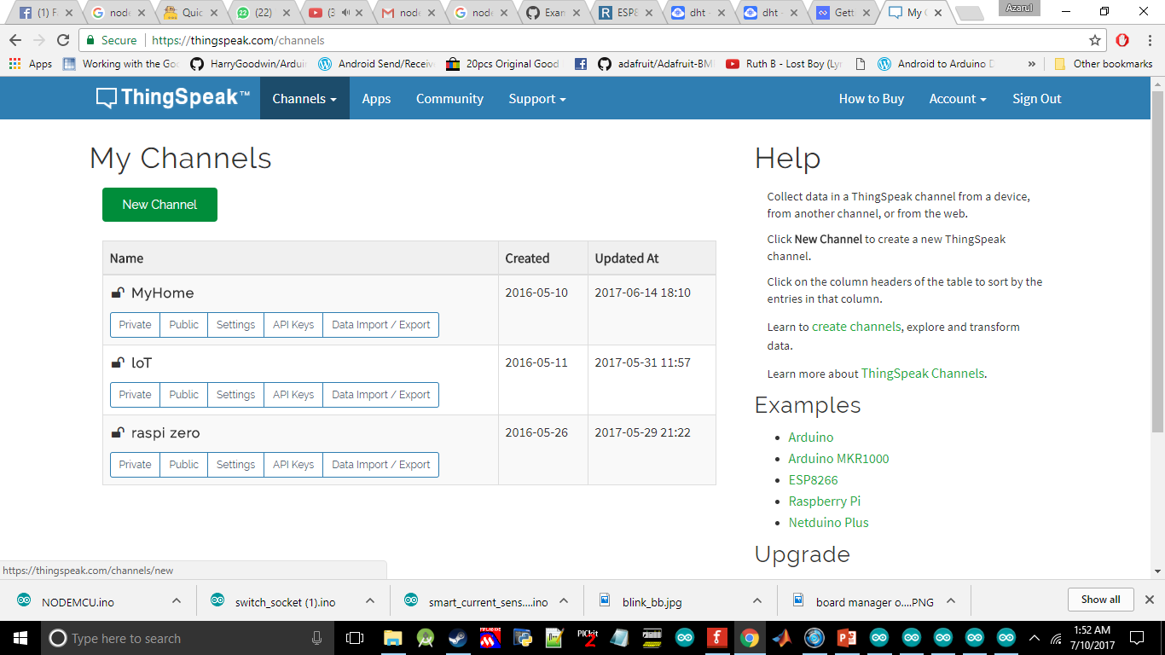
NADI ELECZONE SOLUTION
Setup thing speak
1
Goto https://thingspeak.com/ and signup. You need to validate account by using your email.
3
Give a name to your channel and field for each of your sensor data. Scroll to the bottom and click save channel.
2
Click New Channel

Slide 21
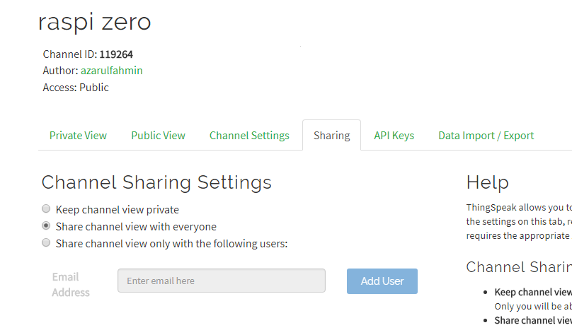
NADI ELECZONE SOLUTION
Setup thing speak
1
Go to Sharing then tick on Share channel view with everyone

Slide 22
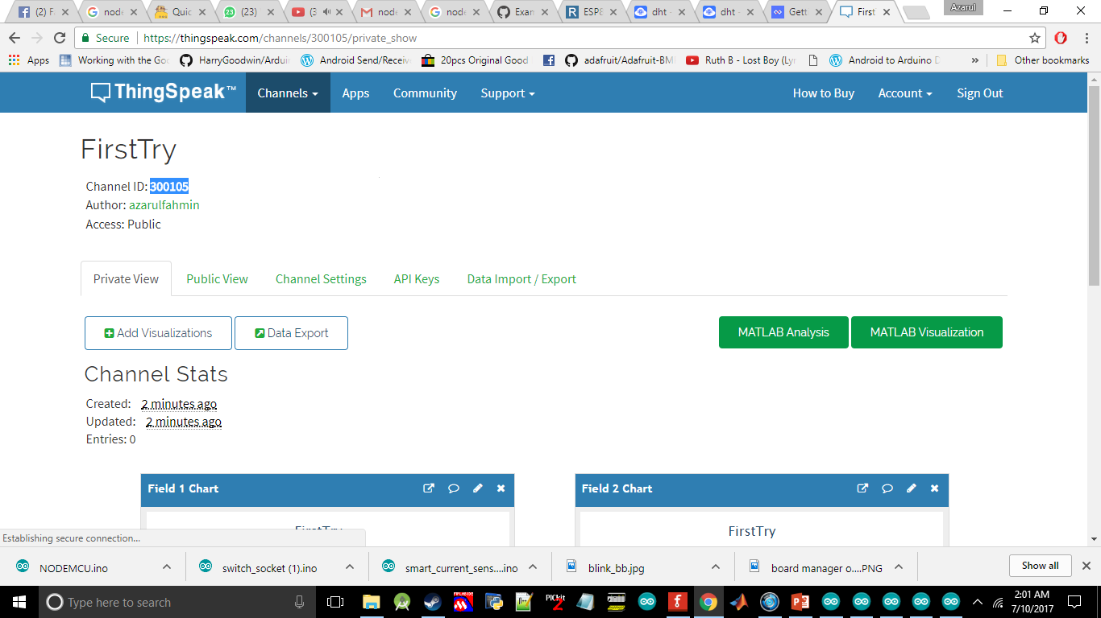
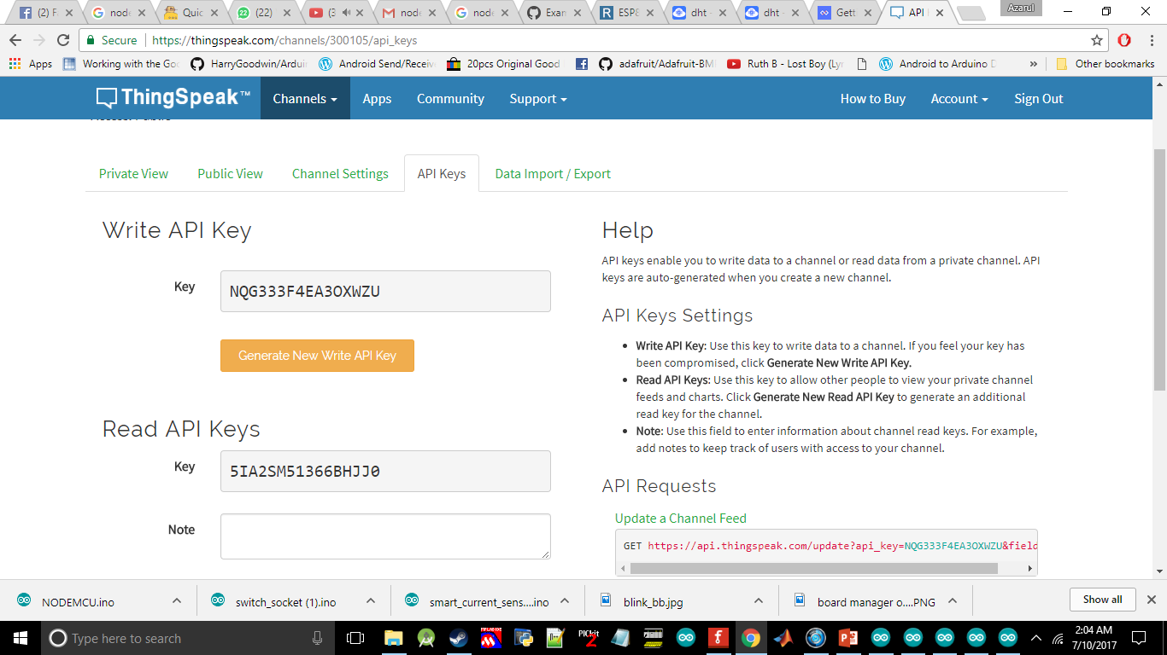
NADI ELECZONE SOLUTION
Lesson 3
Lesson 3 : Sending data from NodeMCU to the cloud then mobile apps
1
Save your Channel ID in notepad
2
Save also this two api key

Slide 23
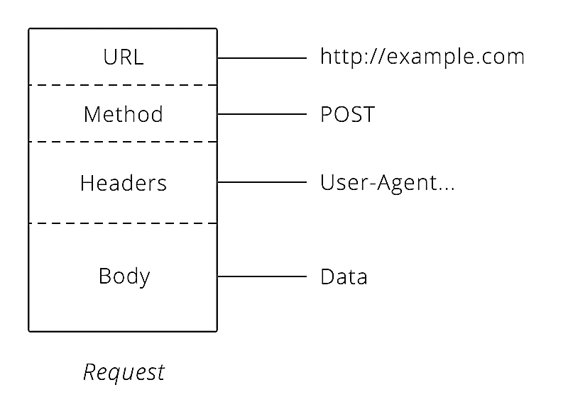

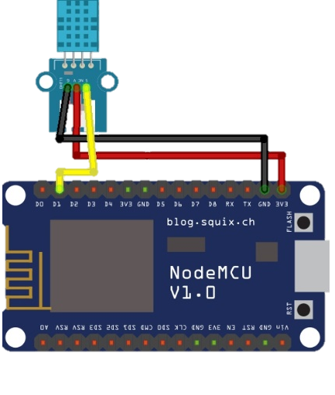
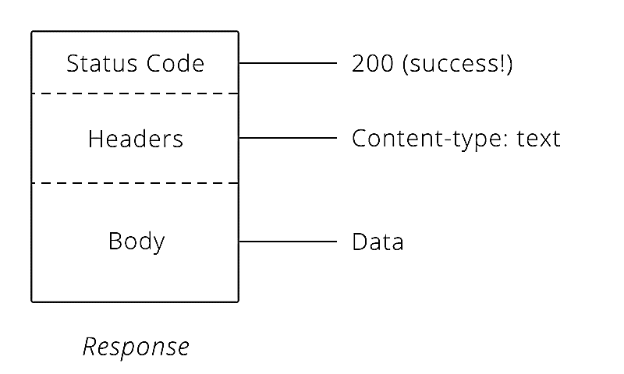
NADI ELECZONE SOLUTION
Lesson 3
HTTP Request
HTTP Response
HTTP Request

Slide 24
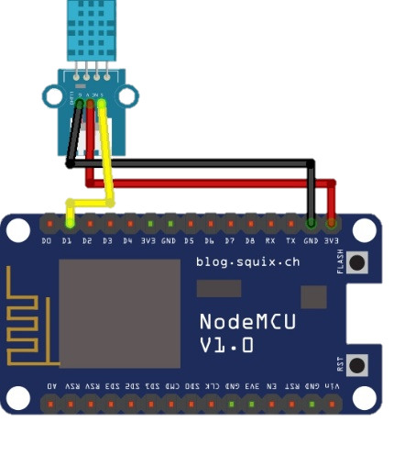
NADI ELECZONE SOLUTION
Lesson 3
POST /update HTTP/1.1
Host: api.thingspeak.com
Connection: close
X-THINGSPEAKAPIKEY: GVJHFB678JHU
Content-Type: application/x-www-form- urlencoded
Content-Length: 20 Data: field1=30&field2=40

Slide 25
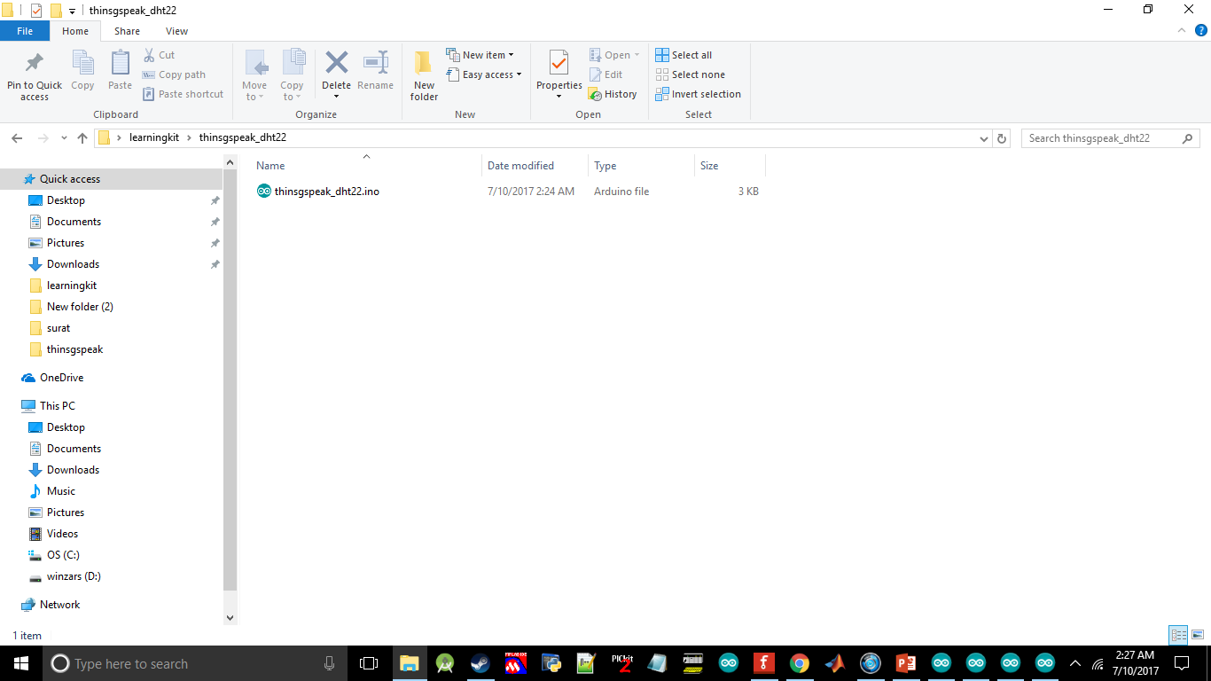
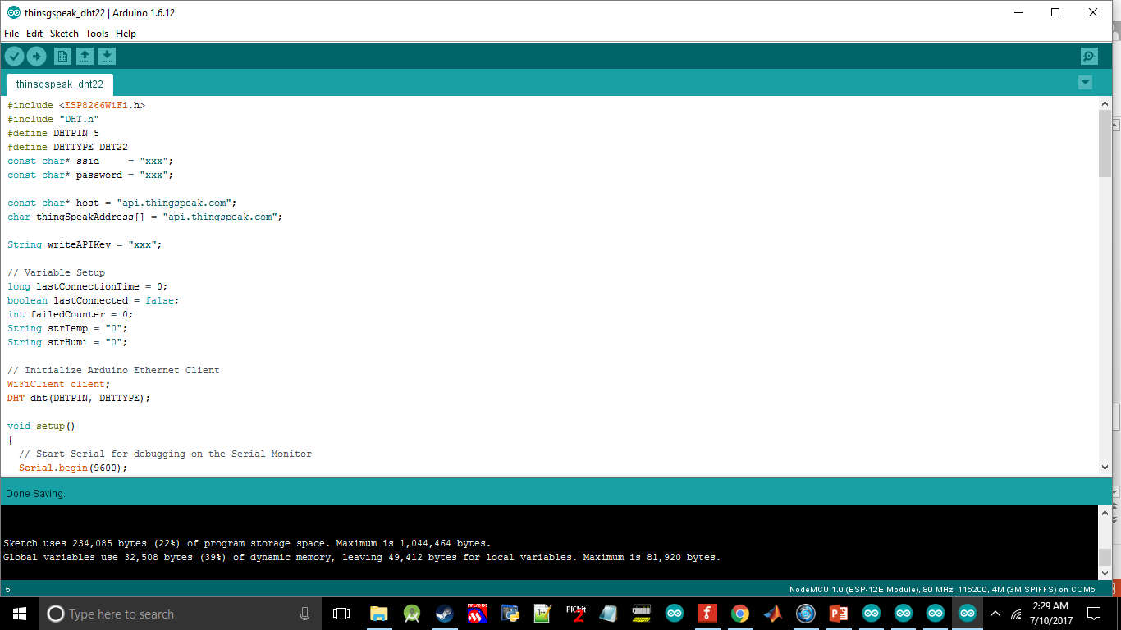
NADI ELECZONE SOLUTION
Lesson 3
1
Open thingspeak_dht22.ino
After done. Please take a look at thinspeak channel to see your incoming data.
2
Change xxx at ssid according to your Wi-Fi name
Change xxx at password according to your Wi-Fi password Change xxx at writeAPIKey according your api key in thingspeak

Slide 26
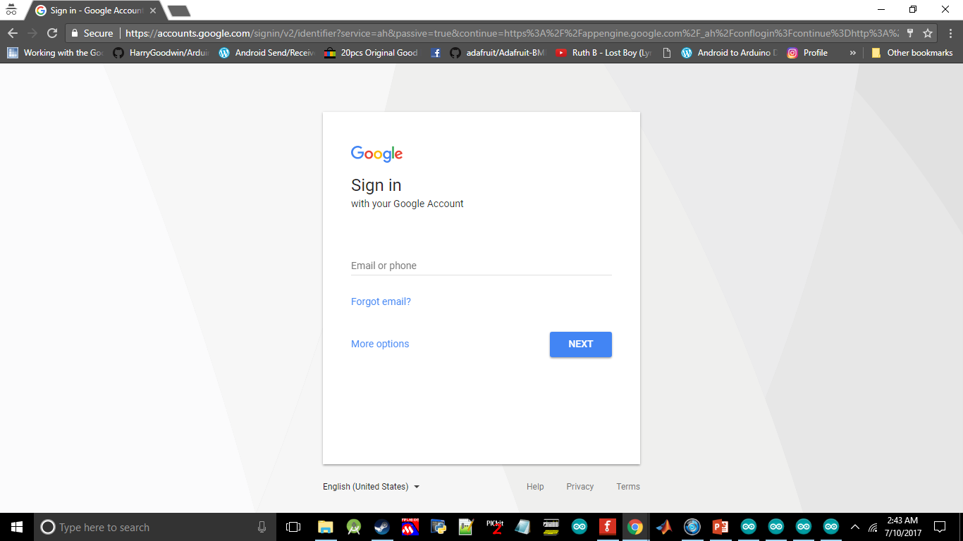
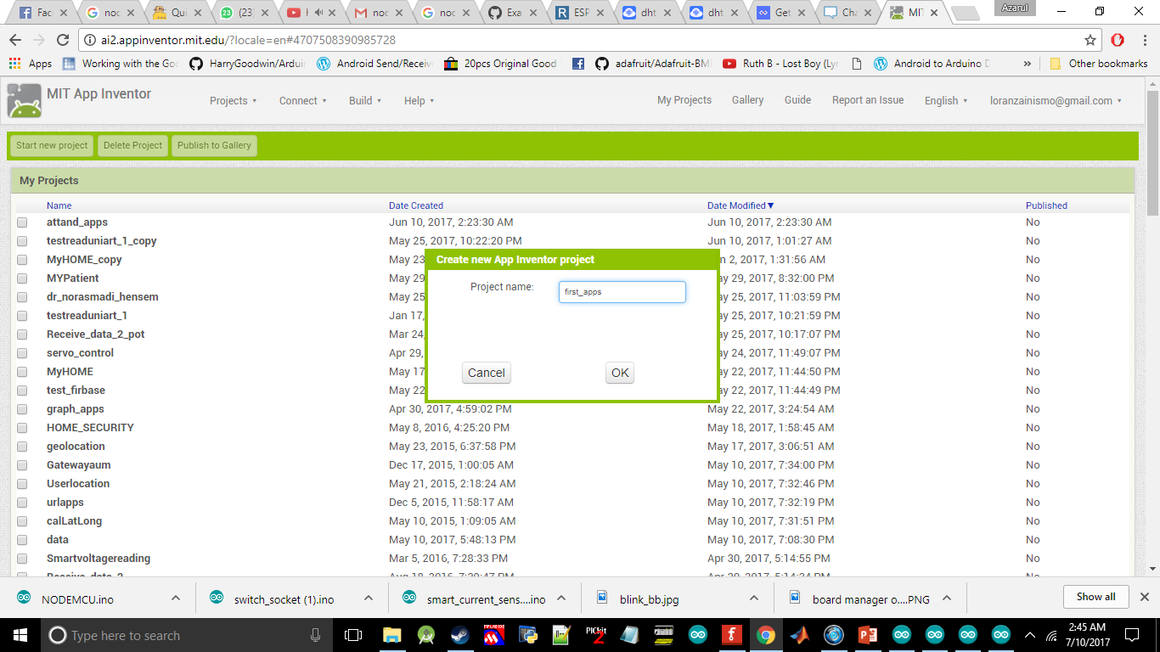
NADI ELECZONE SOLUTION
Lesson 3
1
Open http://ai2.appinventor.mit.edu/ and sign-up
2
Start new project and give a name to your apps

Slide 27
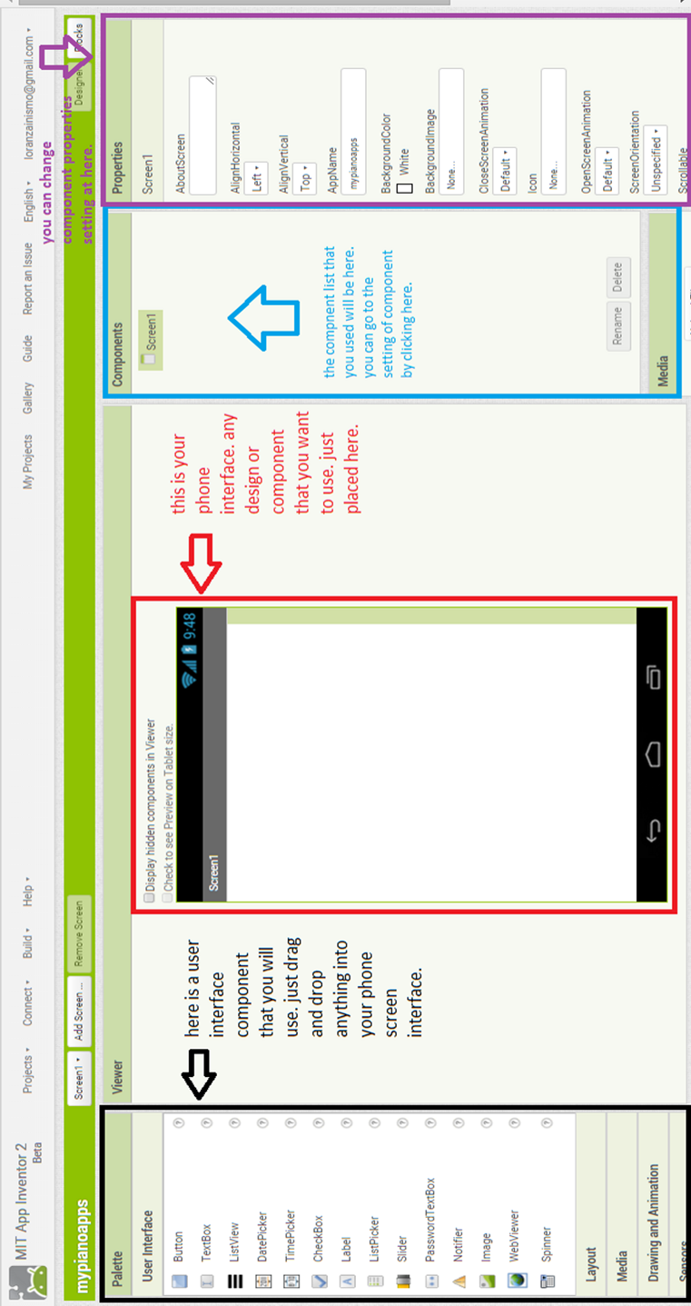
NADI ELECZONE SOLUTION
LESSON 3

Slide 28
NADI ELECZONE SOLUTION
Lesson 3
To change your properties for your component. You need to edit it here.

Slide 29
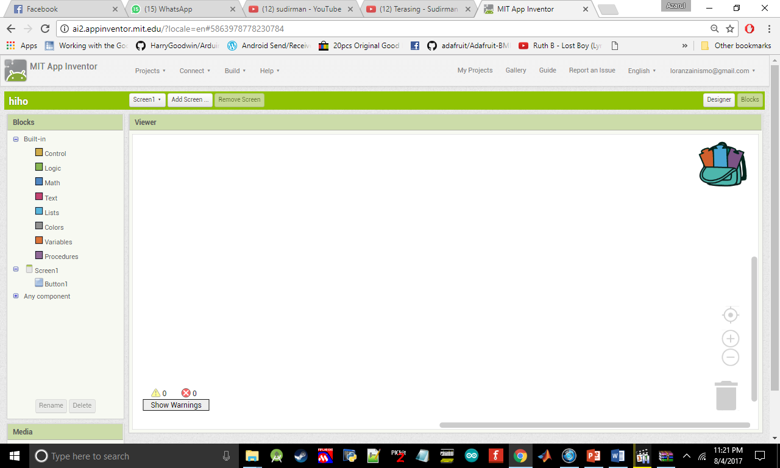
NADI ELECZONE SOLUTION
Lesson 3
Here is all of syntax that you will use in programming the android apps. The block that you drag form here can be compare by the colour of the block
If you want to delete your block you can dump in this bin

Slide 30
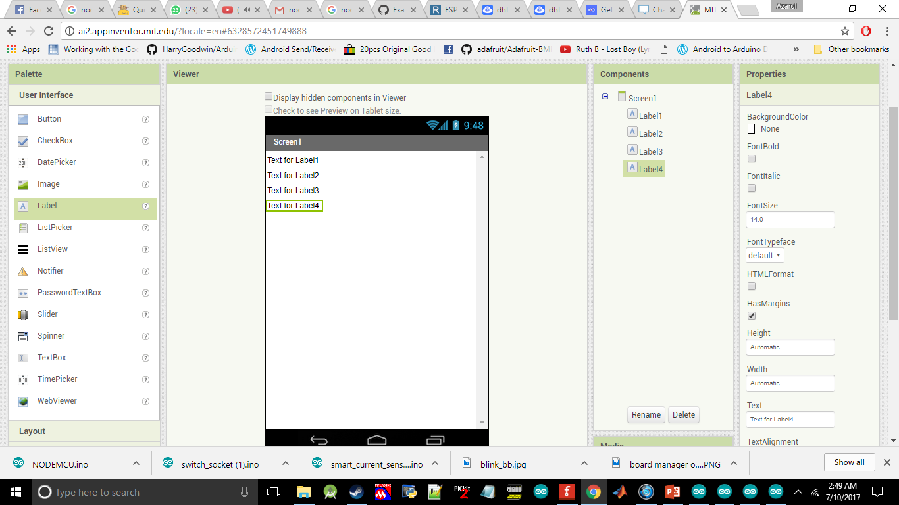
NADI ELECZONE SOLUTION
Lesson 3
Drag Lable4 into your screeen

Slide 31
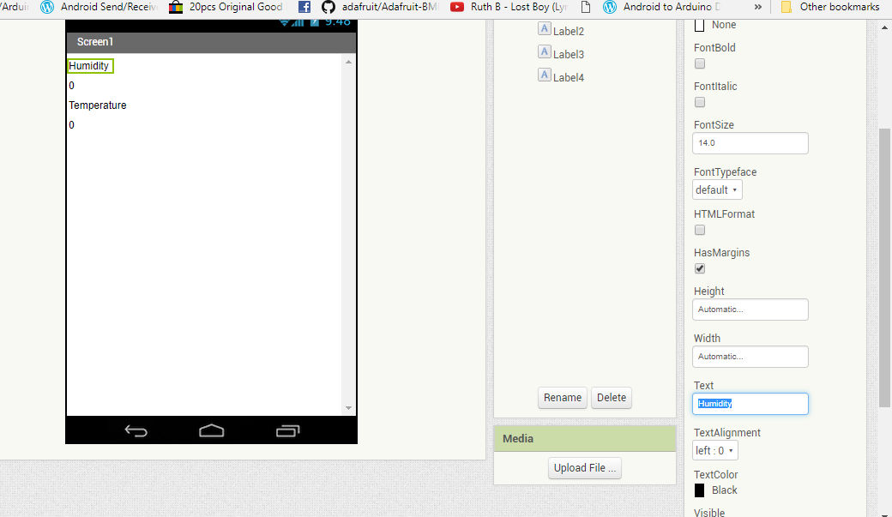
NADI ELECZONE SOLUTION
Lesson 3
You need to change text for each label at here.

Slide 32
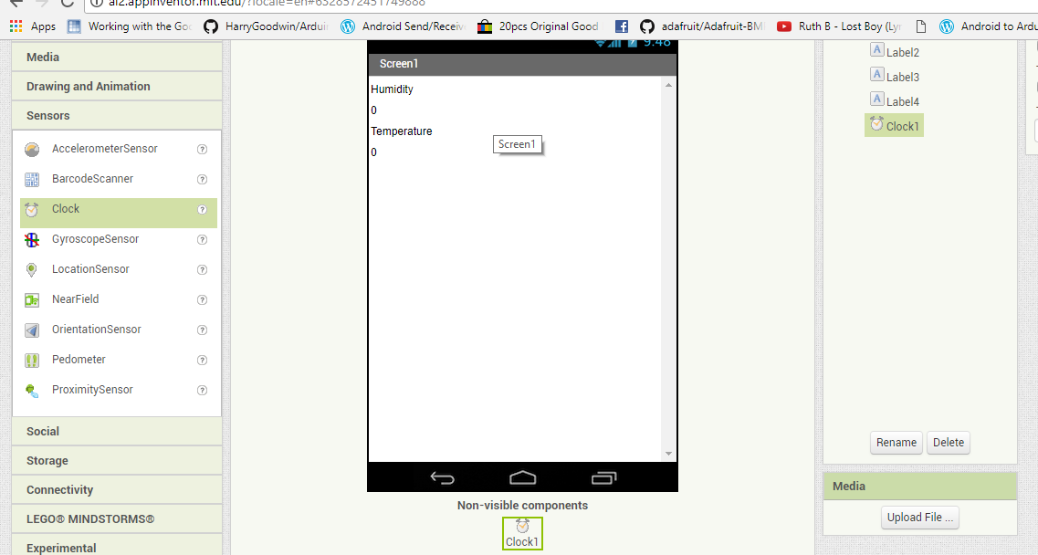
NADI ELECZONE SOLUTION
Lesson 3
Put clock into screen that you can get from Sensors

Slide 33
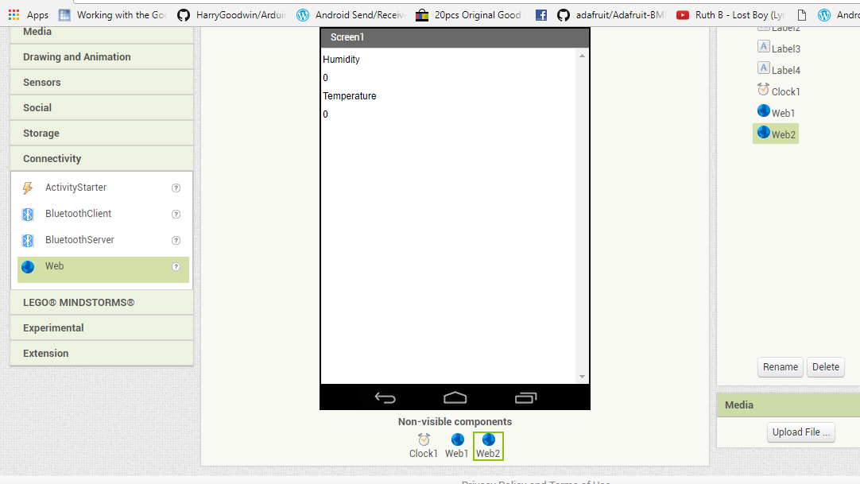
NADI ELECZONE SOLUTION
Lesson 3
Drag two Web form Connectivity into screen

Slide 34
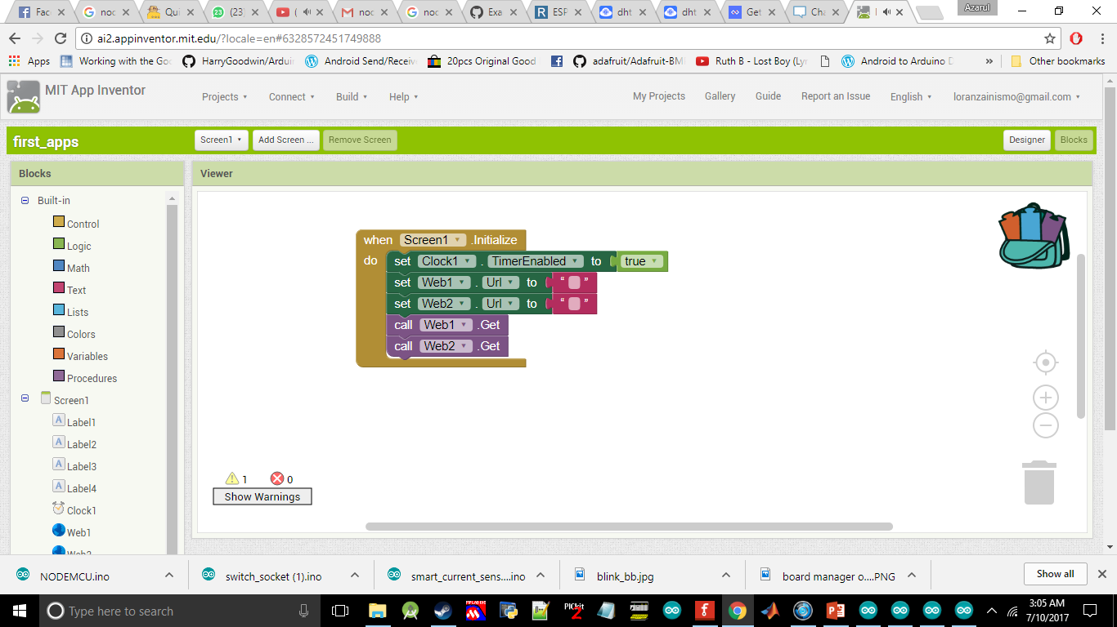
NADI ELECZONE SOLUTION
Lesson 3
Go to the block then drag all of this component into the coding space

Slide 35
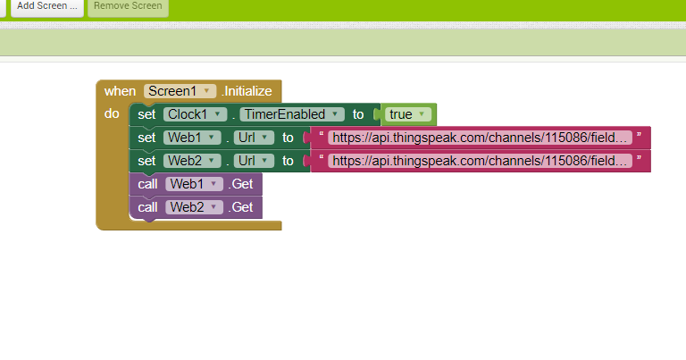
NADI ELECZONE SOLUTION
Lesson 3
Put https://api.thingspeak.com/channels/channel id anda /fields/ nombor field /last? Into text field

Slide 36
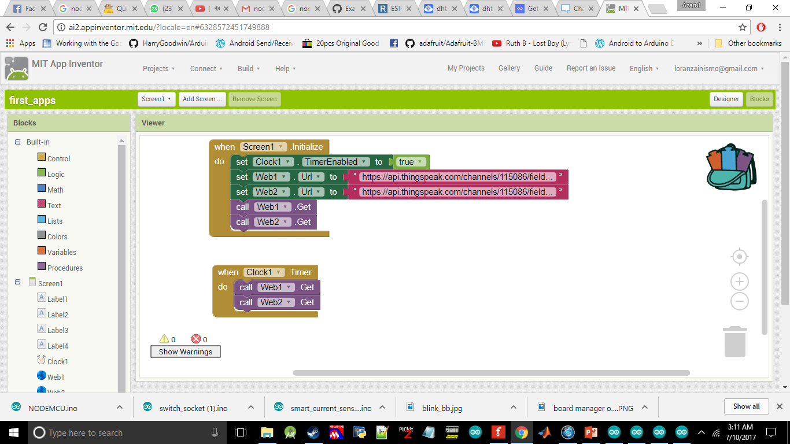
NADI ELECZONE SOLUTION
Lesson 3
Put Clock1.Timer and call web get

Slide 37
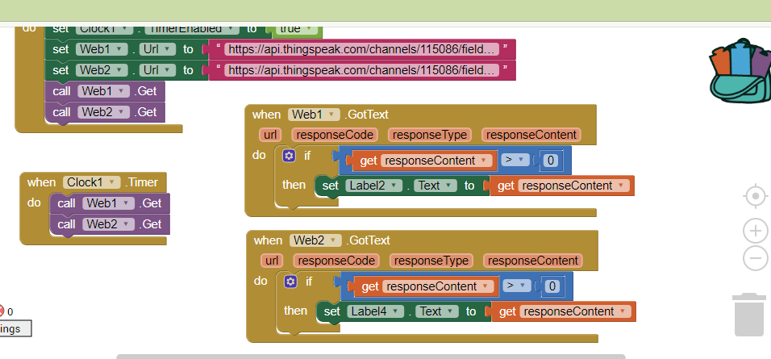
NADI ELECZONE SOLUTION
Lesson 3
Drag web1 and web2 got text

Slide 38
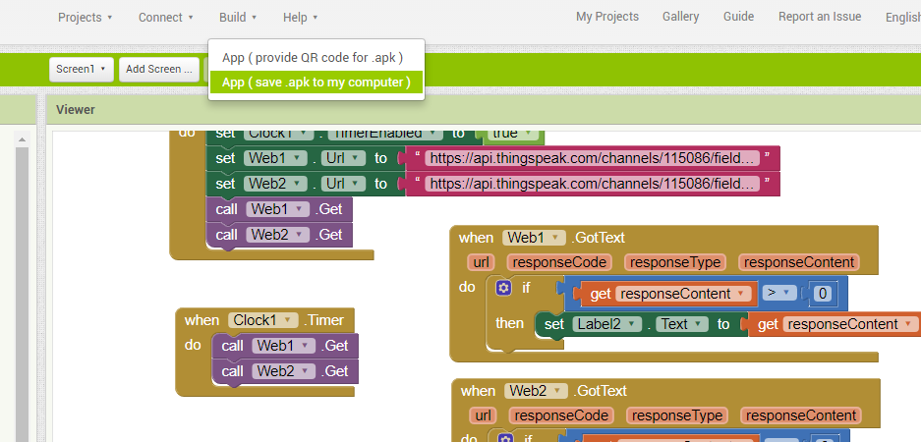
NADI ELECZONE SOLUTION
Lesson 4
Go to the build and click on App(save .apk to my computer). Then install it in your phone

Slide 39
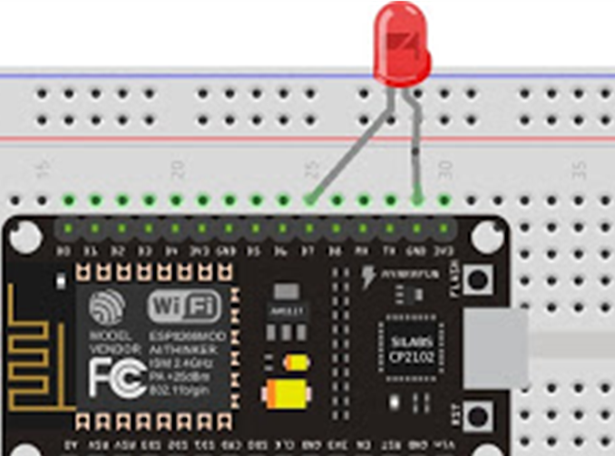

NADI ELECZONE SOLUTION
Lesson 4
Lesson 4 : Send data from android smart phone to NodeMCU through cloud
1
Put the LED at D7
2
Open thingspeak_controlled.ino

Slide 40

NADI ELECZONE SOLUTION
Lesson 4
Create another Thingspeak channel
that will used in this lesson
Change xxx at ssid according to your Wi-Fi name
Change xxx at password according to your Wi-Fi password
Change xxx at myReadAPIKey according to your read api key Change xxx at myChannelNumber according to the channel number

Slide 41

NADI ELECZONE SOLUTION
Lesson 4
Drag 2 button into screen1

Slide 42

NADI ELECZONE SOLUTION
Lesson 4
Change the button text into
ON and OFF

Slide 43

NADI ELECZONE SOLUTION
Lesson 4
Drag 2 web into screen

Slide 44

NADI ELECZONE SOLUTION
Lesson 4
Algorithm at the block part

Slide 45

NADI ELECZONE SOLUTION
Lesson 4
If(data == 30){
//ON LED } else //OFF LED
https://api.thingspeak.com/update?api_key=write api key &field anda =data
DONE! Build The Apps

Slide 46


NADI ELECZONE SOLUTION
Lesson 5
Lesson 5: Combine the lesson 4 and 5
1
Put the LED into D7 and
Combine with DHT sensor
2
Open file thingspeak_combine.ino

Slide 47
NADI ELECZONE SOLUTION
Lesson 5
Build your own android apps

